Slide 1

ARTIFICIAL INTELLIGENCE PROJECT
TYPING SPEED CALCULATOR and
ANALIZING SENTIMENT OF THE TEXT

Slide 2
GROUP MEMBERS
Gurleen kaur
Sagar grover

Slide 3
CONTENTS
1) Problem statement
2) Software used
3) Key Features/Benefits
4) Deliverables
5) How AI is helping us?
7) Applications of AI
9) Our project
10) Sentiment analysis
11) Output

Slide 4

PROBLEM STATEMENT
It is creating a platform to discover the typing speed of any user.
It is also telling the sentiments . So it is quit interesting to know what the text is giving in the form of sentiments or expressions.

Slide 5
SOFTWARE USED
Install library from COMMAND PROMPT by typing :
a) pip install Pygame
b) pip install nltk
c) pip install textblob
Python 3.7.0 .
PC with good internet connection.

Slide 6
KEY FEATURES/BENEFITS
To make assignments, projects, presentations online there is perfect way to type the required or study material through keyboard which needs typing speed to be sufficient in order to utilize the time.
The productivity of a business depends on how things are done faster. To complete your work faster it is important to develop TYPING SKILLS.
Saves time for other sort of works if typing speed is accurate othervise the focus on screen will be less then focus on the keyboard for giving inputs.

Slide 7
KEY FEATURES/BENEFITS
Typing helps you to work comfortably on the computer, it aids in communicating with colleagues and customers, creating documents, and finding new information.
Improve your focus and not pecking at the keyboard.
The program also analyze and depict the sentiment of typed text .
Using sentiment analysis tools allows us to evaluate the attitudes of your target consumers – that can make or break your brand’s or organization reputation.

Slide 8
DELIVERABLES
Power point presentation.
Source code
Video tutorial

Slide 9
How AI is helping US?
ARTIFICAL INTELIGENCE is not here to replace us. It augments our abilities and makes us better at what we do. The main thing is AI algorithms learn differently than humans, they look at things differently. They can see relationships and patterns that escape us. This human , AI partnership is vary useful and offers much more opportunities.
A) Give us better vision, better understanding, better memory and much more.
B) Breakdown economic barriers, including language and translation barriers.

Slide 10

Applications of AI
The examples of ARTIFICIAL INTELLIGENCE are:
1 Face detection and speech recognition
2 Chatbot
3 Assistants ( ALEXA,SIRI )
4 Social media
5 NETFLIX

Slide 11
OUR PROJECT DESCRIPTION
“Typing speed calculator”
with
“Sentiment analysis of typed text”
It is going to display a sentence and when the user will give a click on the rectangular box appearing on the screen the time counter will start and the time counter will stop it’s activity when the user presses the enter key from keyboard.
After that the game will display a message which will tell how much words have you written per minute , accuracy and time also.
There is also another section which is going to Analyze the sentence’s sentiment.

Slide 12
OUR PROJECT DESCRIPTION
Sentiment analysis( also known as opinion mining or emotion AI) refers to use of natural language processing, text analysis, computational linguistics, to systematically identify, extract, quantify and study effective subjective information.

Slide 13
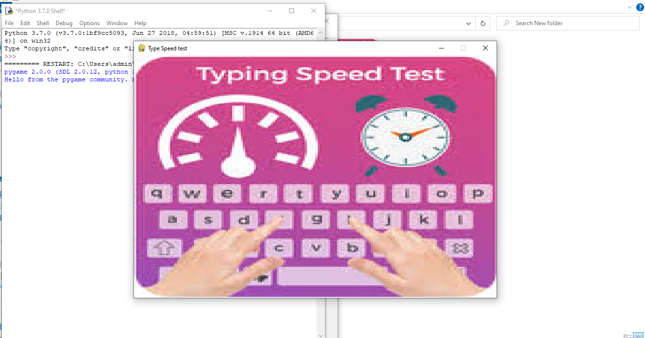
OUTPUT

Slide 14
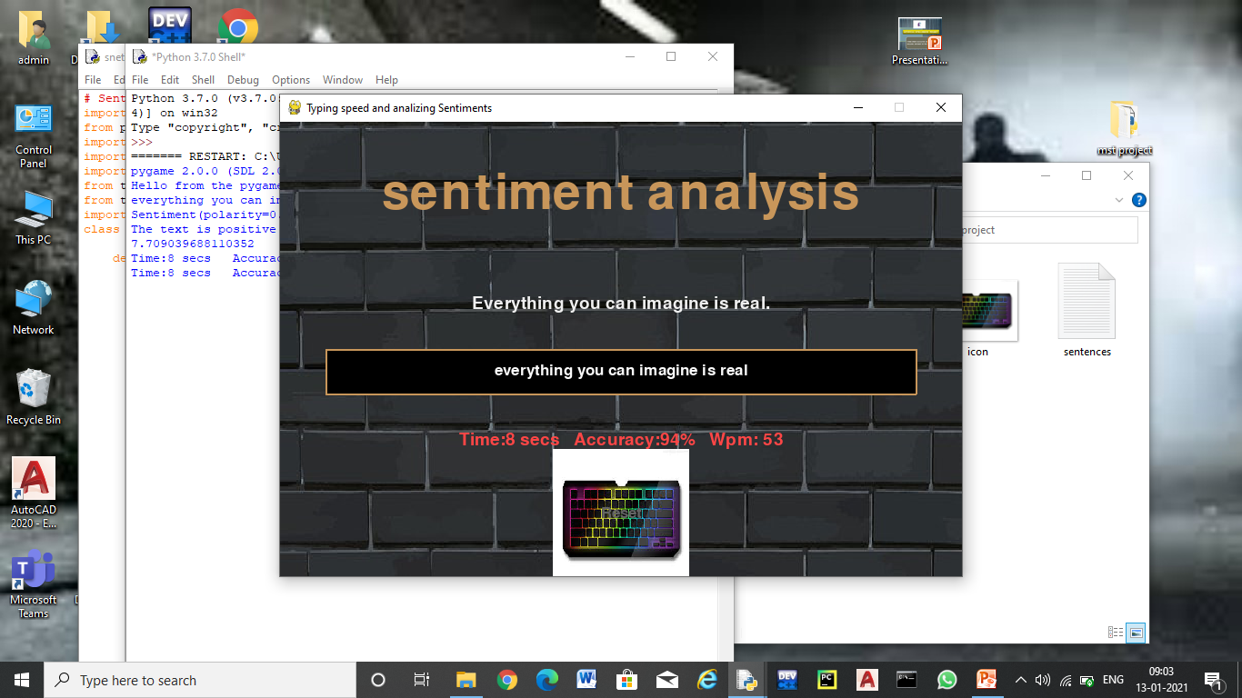
OUTPUT

Slide 15
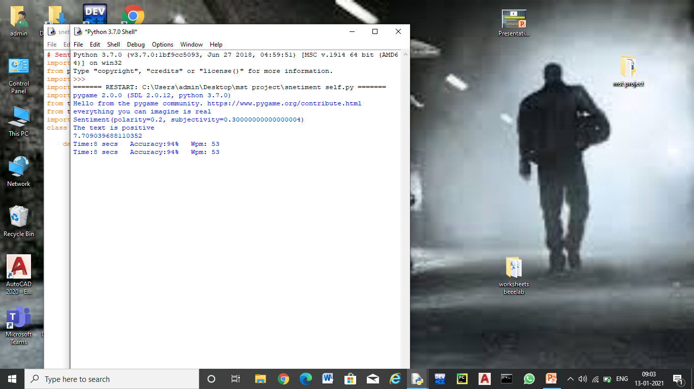
OUTPUT

Slide 16

Thank you

